Slide 1




Research Presentation Presented by: Joseph Chorbajian, Aniruddha Gawande, Abhishek Jajoo, Satyam Sharma, Ishan Unnarkar Group 4
“Robust and Sparse Linear Discriminant Analysis via an Alternating Direction Method of Multipliers”
by Chun-Na Li, Yuan-Hai Shao, Wotao Yin, and Ming-Zeng Liu
Notes:
Hello! Our group has chosen the paper “Robust and Sparse Linear Discriminant Analysis via an Alternating Direction Method of Multipliers.”
I. Introduction
- Overview of the problem being studied
- Importance of solving the problem
II. Limitations of Classical LDA
- LDA's susceptibility to polluted data
- The SSS problem in L2-norm-based LDA
III. Robust and Sparse Linear Discriminant Analysis
- Explanation of the proposed method
- Benefits of the method over classical LDA
IV. Alternating Direction Method of Multipliers (ADMM)
- Overview of ADMM
- How ADMM is applied to the proposed method
V. Experimental Results
- Description of the experiments conducted
- Comparison of the proposed method to other methods
- Discussion of the results
VI. Conclusion
- Summary of the paper's contributions
- Future work and potential areas for improvement

Slide 2
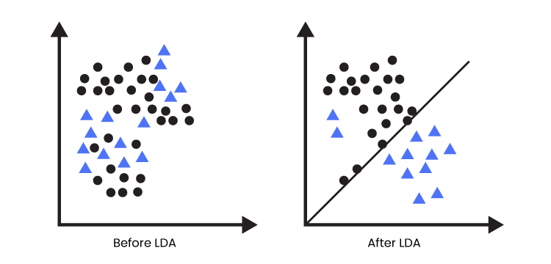
Introduction
Linear Discriminant Analysis (LDA) is a linear classification method used to separate two or more classes of objects or events by projecting them onto a lower-dimensional space.
LDA focuses on separability
Notes:
As we know, Linear Discriminant Analysis is a method that separates two or more classes by projecting them on a lower-dimensional space. While LDA can be used as a linear classifier, we study its purpose as a dimensionality reducer, where it finds vectors pointing in the most discriminative direction by maximizing the between-class variance and minimizing the within-class variance, essentially separating the classes. Its purpose is twofold: LDA can perform feature extraction and the reduced dimensionality of datasets can speed up computation.
However, LDA is not without problems.

Slide 3
Overview of the problem being studied
LDA methods can produce a large number of features, which can lead to overfitting and poor generalization to new data.
LDA methods can be sensitive to outliers, which can adversely affect the classification accuracy.
LDA methods assume that the covariance matrix is the same for all classes, which may not be true in practice and can lead to poor classification accuracy.
Notes:
For example, with high-dimensional data, some LDA methods can produce a large number of features, which may not improve the accuracy on models fed with LDA-fitted data.
Furthermore, typical LDA methods use normalization that is particularly sensitive to outliers. While this may not be a problem in synthetic datasets, real datasets, especially ones with many observations and features, have noisy data and labels. These outliers can exacerbate and can produce suboptimal classification accuracy.
And further optimizations of LDA can produce suboptimal classification accuracy. Typically, LDA methods assume that all classes share the same covariance matrix. If they don’t, then the chance for misprediction only increases.

Slide 4
Importance of solving the problem
LDA is sensitive to outliers which can result in misclassification and poor accuracy.
Overfitting can result in poor generalization to new data.
Covariance matrix assumptions may not be valid in many real-world problems.
When projection vectors drift far from their desired directions they result in poor classification accuracy and reduced usefulness of the model for real-world problems.
Notes:
It’s important to find solutions to LDA’s problems. As we mentioned, any outliers in the data, any overfitting or having too many features, and any false assumptions of the covariance matrix in the data can all produce suboptimal results.
These suboptimal results manifest in projection vectors not pointing in their idealized directions. This throws off LDA’s classification accuracy or, if used as feature extraction, its inability to find the most important vectors. It’s important to keep this in mind for real-world problems. This paper attempts to solve these problems by being more robust, or more resilient to outliers and noise, and using different methods than a typical LDA.

Slide 5
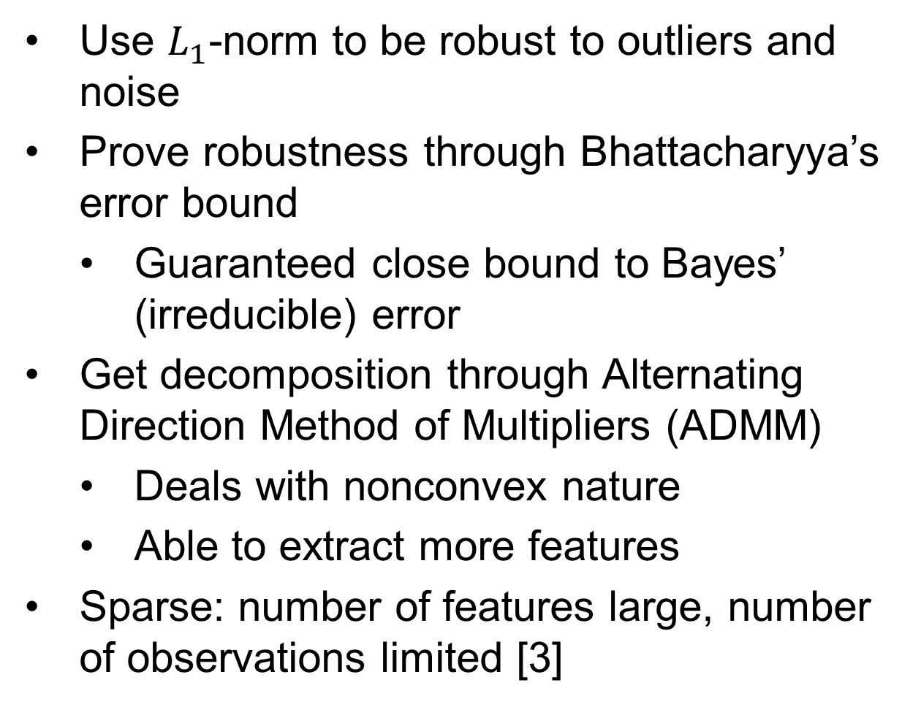
Robust LDA
Use $L_{1}$-norm to be robust to outliers and noise
Prove robustness through Bhattacharyya’s error bound
Guaranteed close bound to Bayes’ (irreducible) error
Get decomposition through Alternating Direction Method of Multipliers (ADMM)
Deals with nonconvex nature
Able to extract more features
Sparse: number of features large, number of observations limited [3]
Notes:
Before we can talk about the paper’s contribution, let’s talk about how L1-norm is more robust. L1-norm is the sum of the absolute value of the entries in a given vector. In this case, we take the norm of the scatter of the points that share the same class. Typical LDA methods use L2-norm, which struggles with a small sample size problem. Other researchers have formally proven that L1-norm is more robust than L2-norm, which is the driving factor as to why we use L1-norm in this new method.
Now let’s talk about the paper’s contribution. In order to truly prove that L1-norm is the most appropriate for this problem, the authors of this paper prove its robustness through Bhattacharyya’s error bound, a measure of how similar two distributions are. The two distributions we compare are the data and its dimensionally-reduced projection. Minimizing this error is essential in getting accurate reductions. Thankfully, the authors proved that it’s a close bound to Bayes’ error, also known as the irreducible error.
For dimensional reduction to happen, we need a way to get the most important features. Typically, you would use eigendecomposition, but we use an Alternating Direction Method of Multipliers instead for L1-norm. Not only can it work with the nonconvex nature of LDA (that is, the problem has multiple local minima), it also doesn’t have the same restriction where the number of features must be less than the number of classes minus one (because that is the rank of the problem instance matrix that eigendecomposition struggles with).
A variant of RLDA, Robust Sparse LDA, or RSLDA, can work with fewer observations and while being able to extract more features. It’s considered a variant because of an additional constraint on the discriminant direction during ADMM optimization. It typically performs worse than RLDA on data that works on both variants, but in some cases, it can perform better.

Slide 6
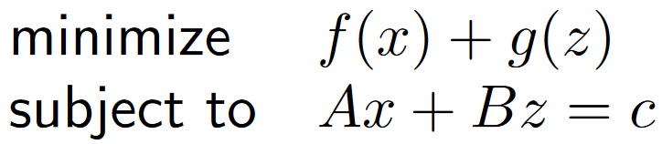
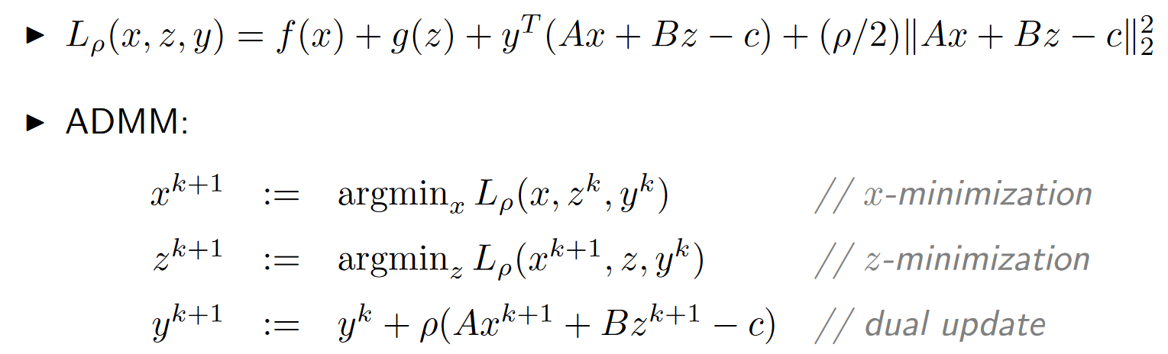
Alternating Direction Method of Multipliers
Rewrite the minimization to the form
Add penalty
We know how to minimize efficiently
Figure 1. [2]
Figure 2. Augmented Lagrangian and minimization of two variables [2]
Notes:
Alternating Direction Method of Multipliers is unique in how it optimizes. Instead of minimizing any generic function with one variable, it minimizes the sum of two functions with different variables.
If we add a penalty to the sum, then we create an augmented Lagrangian. This helps us because other researchers found an efficient way to minimize both variables at the same time within one iteration. Finding the arguments of the minima for both variables can also be done in parallel, speeding up computation.
There is a lot more to ADMM, including its requirement of a simple function, but we give a high-level overview on how it performs our decomposition.

Slide 7
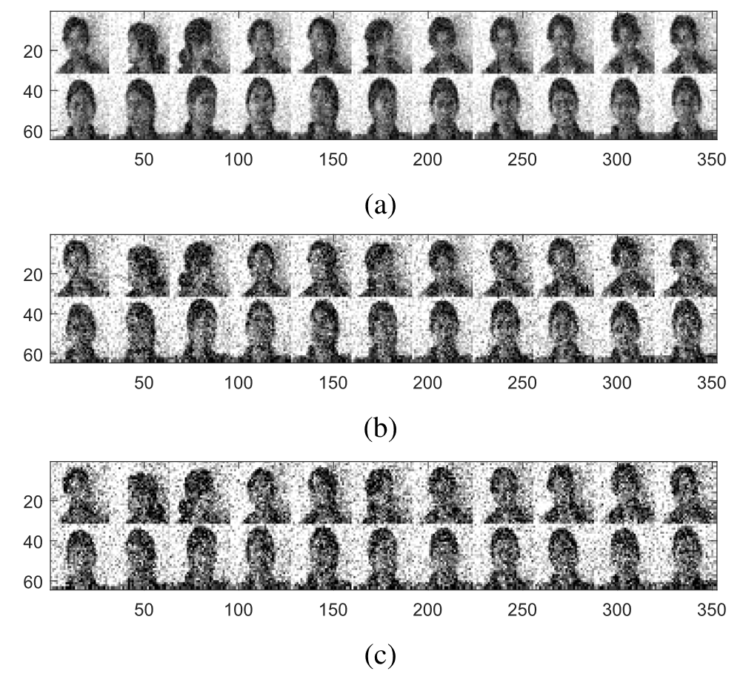
Methodology
Compare multiple dimensionality reducing algorithms
Use artificial and real datasets
Measure accuracy and time
Figure 3. Samples of the noisy female Indian dataset [1]
Notes:
In order to test whether their Robust LDA has real improvement, the authors decided to test it against both artificial and real datasets. Here, they compare it against PCA, Principal Component Analysis, PCA with L1-norm, LDA, regularized LDA, LDA with L1-norm, and other methods.
They created two artificial datasets with 2 dimensions, with both dimensions being normally distributed with different parameters. Each dataset has 50 samples, but one dataset has one outlier and the other has two. For the real dataset, they used the images of Indian female faces, with each image being 32x32 pixels and 8-bit grayscale. To test robustness, they add normally distributed noise to each image.

Slide 8
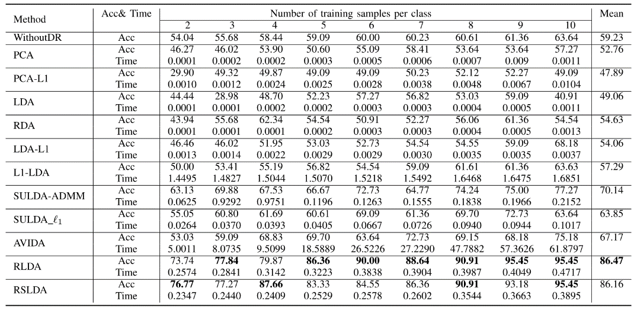
Experimental Results - I
RLDA and RSLDA are new LDA (Linear Discriminant Analysis) methods that are more reliable and sparser.
They use negative formulations, avoiding the use of L1-norm to solve complex optimization problems.
This allows for the selection of the right regularization term.
The proposed approaches can ensure optimal answers since the RSLDA method combines robustness and sparsity.
Figure 4. Table of results. Bold values indicate best in column [1]
Notes:
Here, we can see the table at the bottom left corner. The middle columns are how many training samples are in each class, starting at 2 up to 10. The rightmost column is the mean accuracy in the female Indian face dataset. Each row is a different method. The authors bolded the best accuracy in each column. It might be hard to see, but the bottom two rows are RLDA and RSLDA, respectively. They contain the best accuracy out of all the methods, with RLDA having the best mean accuracy of 86.47%. Note that we also show the time for each method, but we do not prioritize time as a metric. Plain LDA remains the fastest method but has all the issues we discussed.
Each method that they used had their parameters tuned on the datasets. If we look at L1-LDA, we find that it uses a minus formulation to avoid some problems with finding the best optimization.

Slide 9
Experimental Results - II
Since the suggested RLDA approach leverages Bhattacharyya error bound optimization without this restriction, it is an improvement above L1-LDA.
The ADMM algorithm is employed to solve RLDA and RSLDA.
SULDA and its variants SULDA-ADMM and SULDA 1 seek sparse solutions but do not consider robustness.
RLDA and RSLDA utilize L1-norm to achieve robustness and sparseness, and they are an improvement over SULDA in terms of both these aspects.
Notes:
Because we use Bhattacharyya’s error bound to create a guarantee, we do not have to worry about the same issue with L1-LDA. This can explain how RLDA outperforms L1-LDA.
SULDA, or sparse uncorrelated LDA, are a group of methods that we test against. Despite SULDA-ADMM having the same optimization method we use, it does not consider robustness. SULDA with L1 norm is a faster variant of SULDA-ADMM due to another optimization technique, but at the expense of lower accuracy. Either SULDA model fails to consider both robustness and sparseness, so they perform worse.

Slide 10
Conclusion
The paper proposes a robust and sparse linear discriminant analysis (RSDA) method via an alternating direction method of multipliers (ADMM).
RSDA is able to handle both outliers and noise in the data.
RSDA is also able to find a sparse set of discriminant features.
Experimental results show that RSDA outperforms other state-of-the-art methods on both synthetic and real-world data sets.
Notes:
In conclusion, this paper introduces a robust and a robust sparse LDA by using L1-norm instead of L2-norm. We use ADMM to avoid issues with extracting a high number of features with fewer classes.
Bhattacharyya’s error bound can be used to prove the robustness in RLDA. RSLDA also works optimally on a small dataset if we wanted to extract a large number of features. Both features make it a very practical tool on real-world datasets, outperforming the current state of the art methods in terms of accuracy. It also performs similarly on synthetic datasets, proving it to be a versatile tool.

Slide 11
Thank You!
Notes:
And that’s it! I hope you learned the novel technique that helps improve LDA! Are there any questions?
[Linger on the slide a bit before going to citations.]

Slide 12
Citations
Conclusion
[1]: C. -N. Li, Y. -H. Shao, W. Yin and M. -Z. Liu, "Robust and Sparse Linear Discriminant Analysis via an Alternating Direction Method of Multipliers," in IEEE Transactions on Neural Networks and Learning Systems, vol. 31, no. 3, pp. 915-926, March 2020, doi: 10.1109/TNNLS.2019.2910991.
[2]: Distributed Optimization and Statistical Learning via the Alternating Direction Method of Multipliers (Boyd, Parikh, Chu, Peleato, Eckstein)
[3]: L. Clemmensen, T. Hastie, D. Witten, and B. Ersbøll, “Sparse discriminant analysis"
Notes:
In order to test whether their Robust LDA has real improvement, the authors decided to test it against both artificial and real datasets. Here, they compare it against PCA, Principal Component Analysis, PCA with L1-norm, LDA, regularlized LDA, LDA with L1-norm, and other methods.
For their datasets, they created two datasets with 2 dimensions, with both dimensions being normally distributed with different parameters. Each dataset has 50 samples, but one dataset has one outlier and the other has two outliers. For the real dataset, they used the images of Indian female faces, with each image being 32x32 pixels and 8-bit grayscale. To test robustness, they add normally distributed noise to each image.

